Slide 1
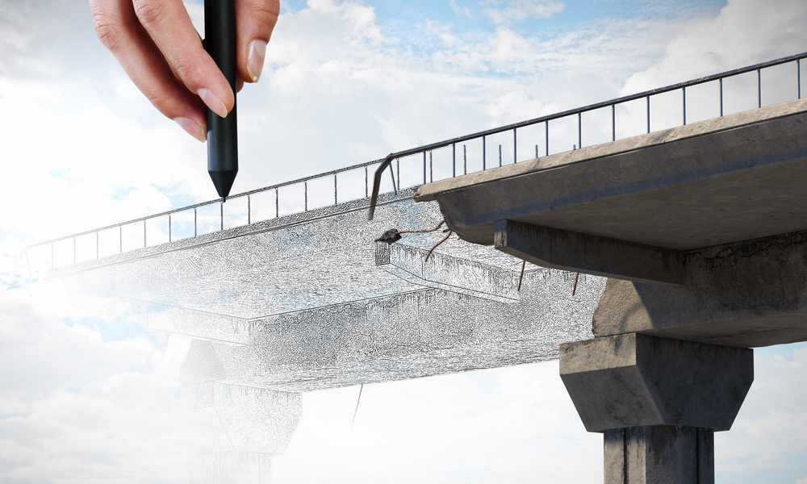
The Bridge to a Decentralized
Future
Ali Abrar Al Haque

Slide 2
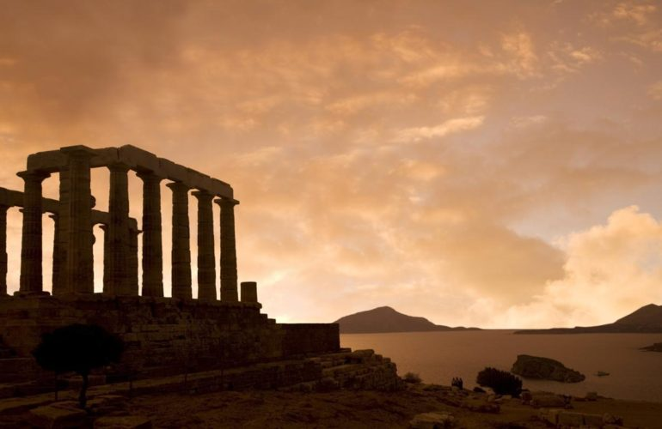
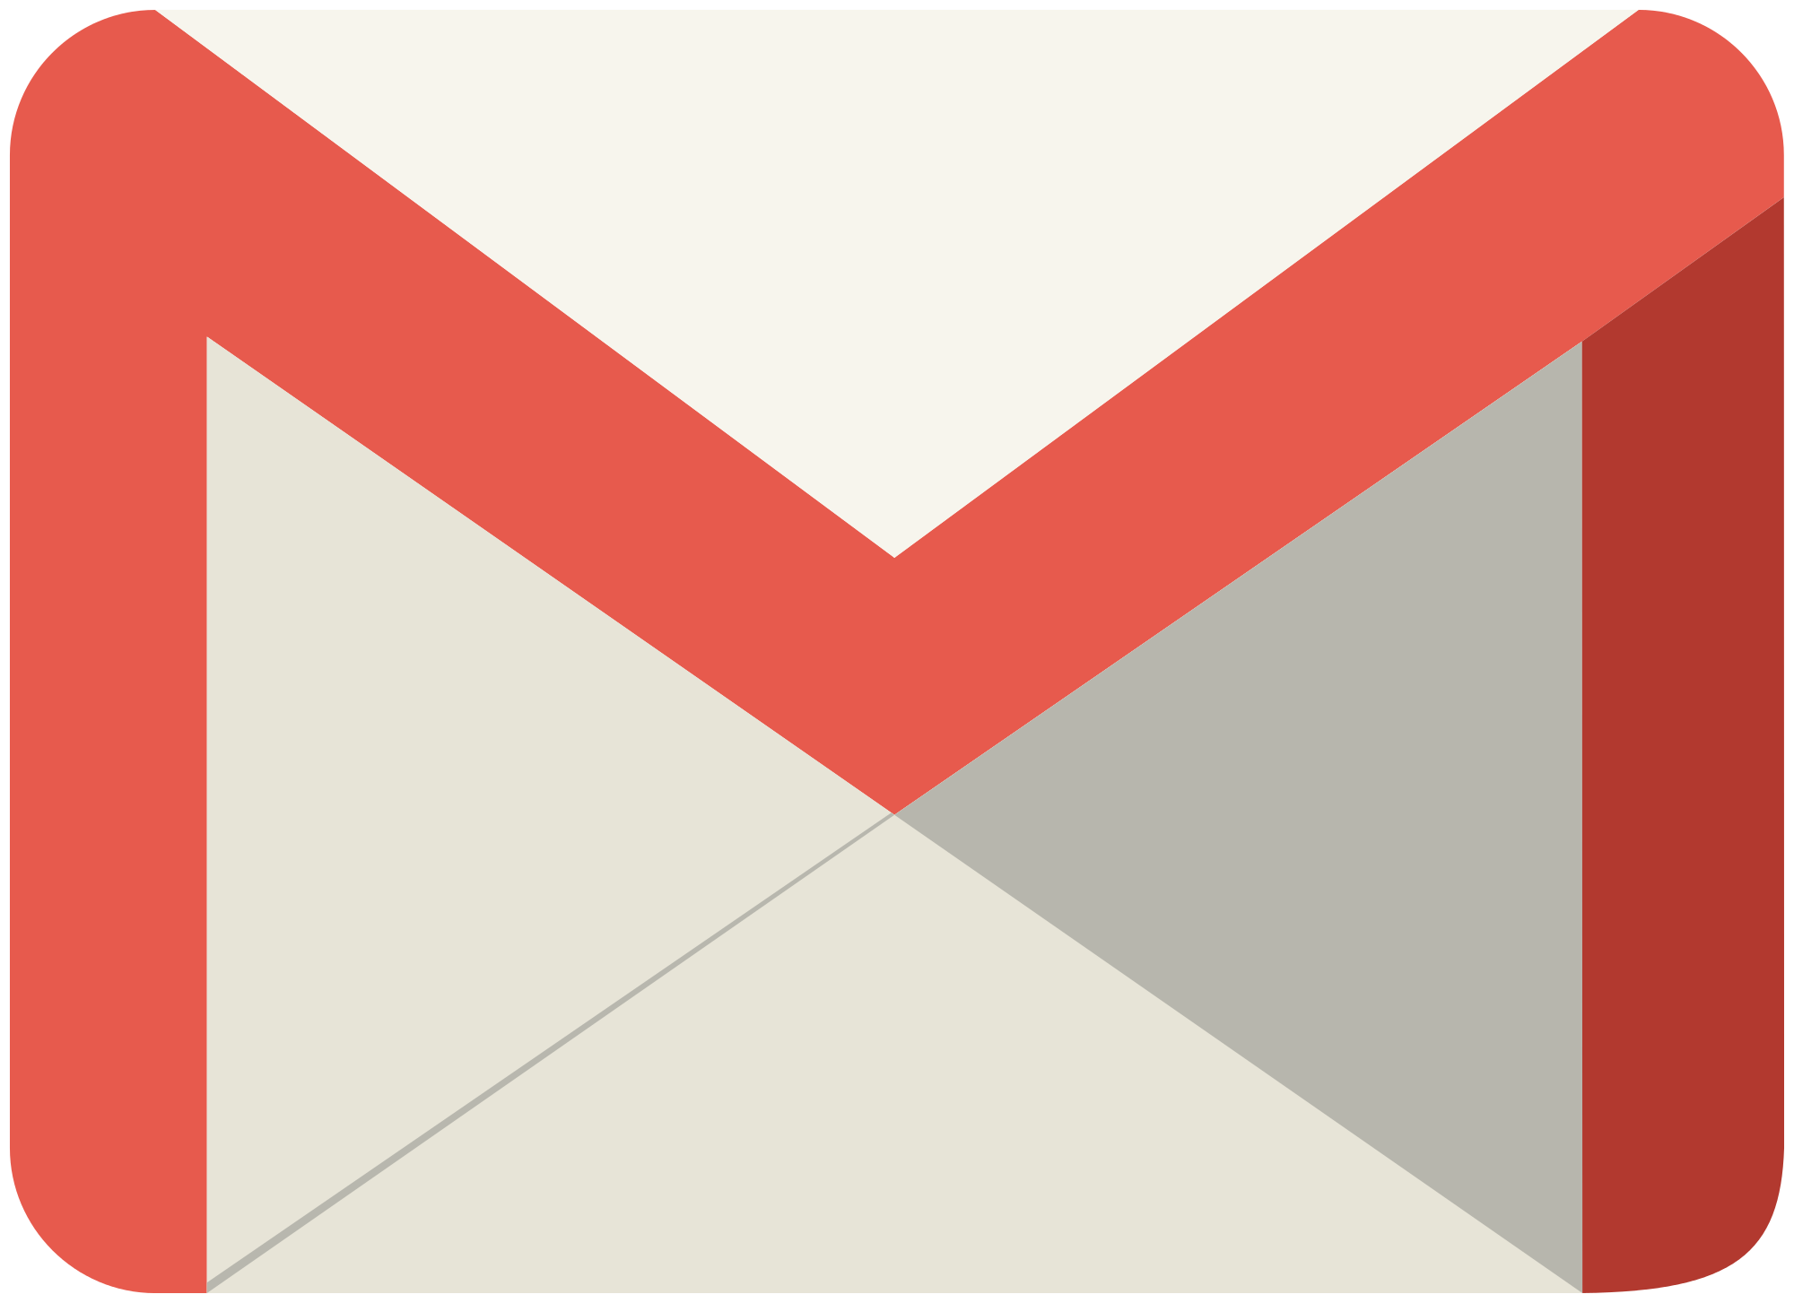
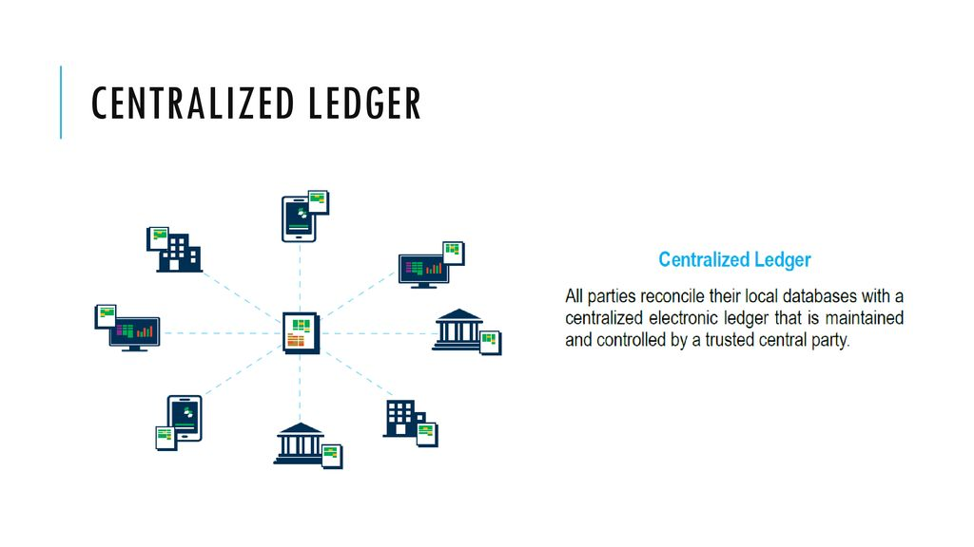
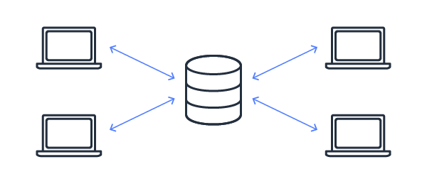




What is Centralization?

Slide 3
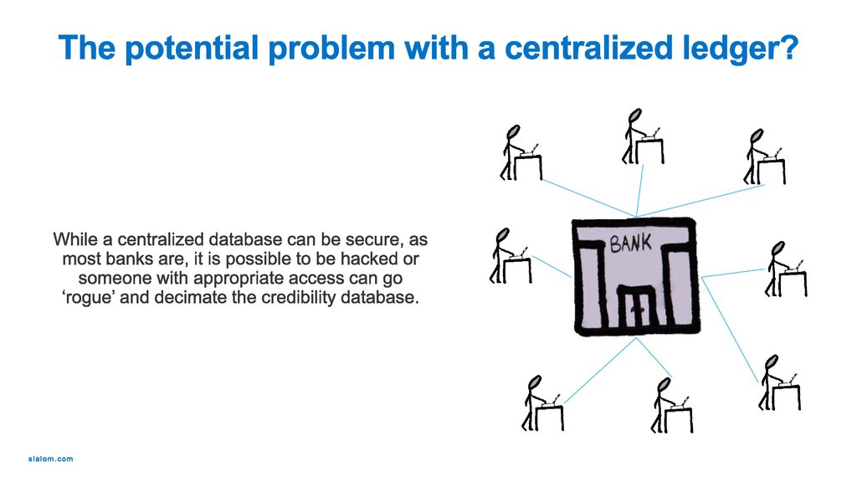
Why Decentralization?
Dictatorship
Can be easily Hacked
Privacy Risk
Vulnerable

Slide 4
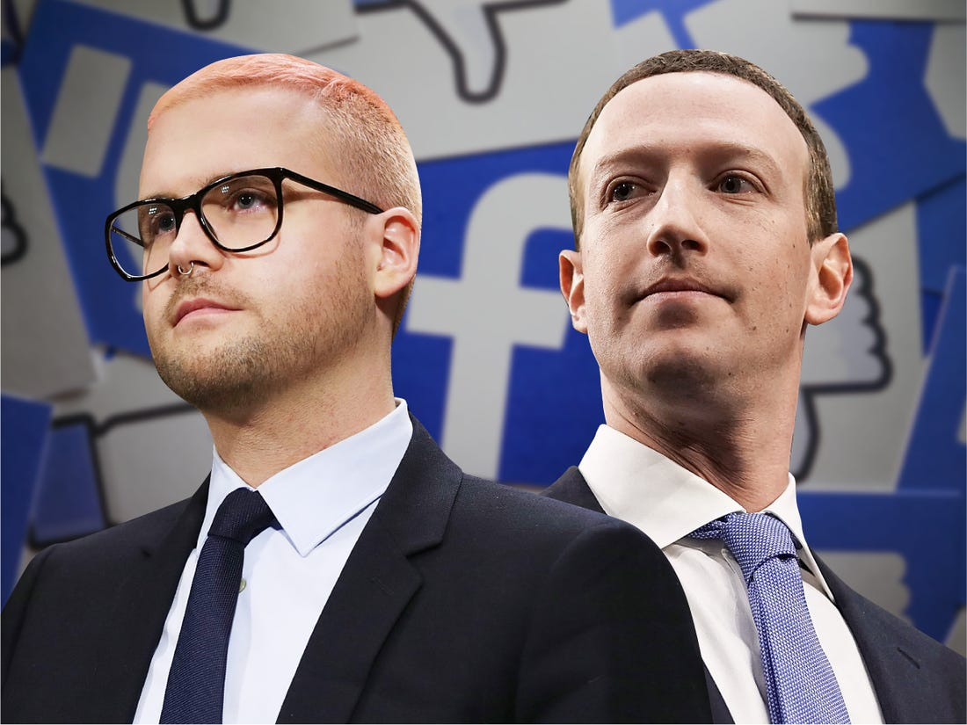
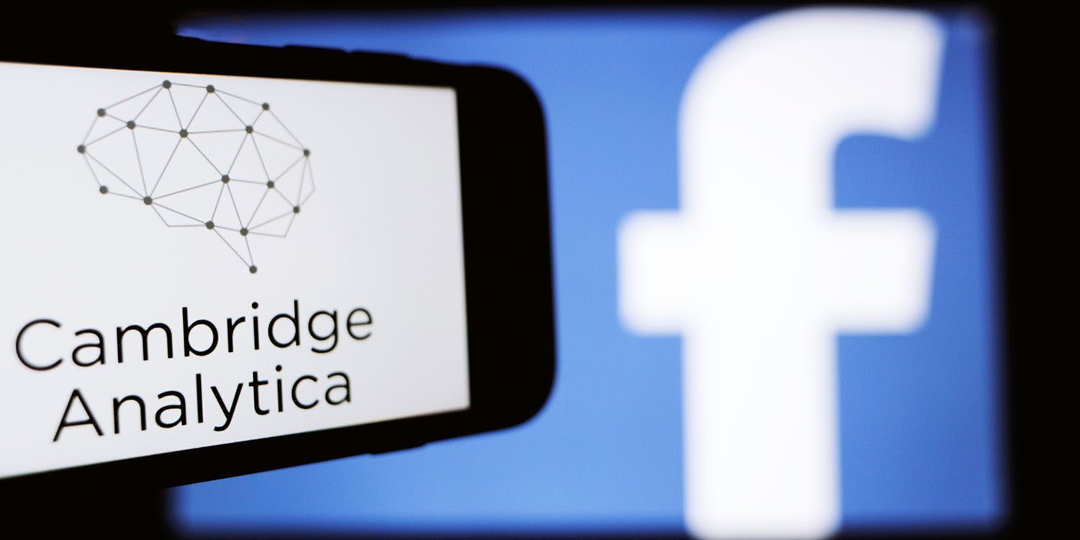
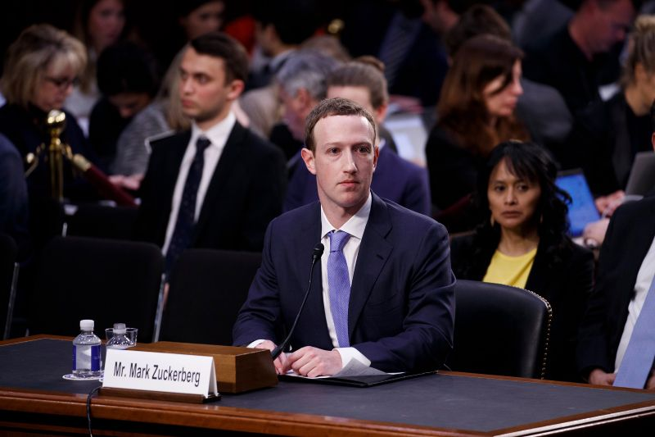
Facebook Scandal
(Cambridge Analytica)

Slide 5
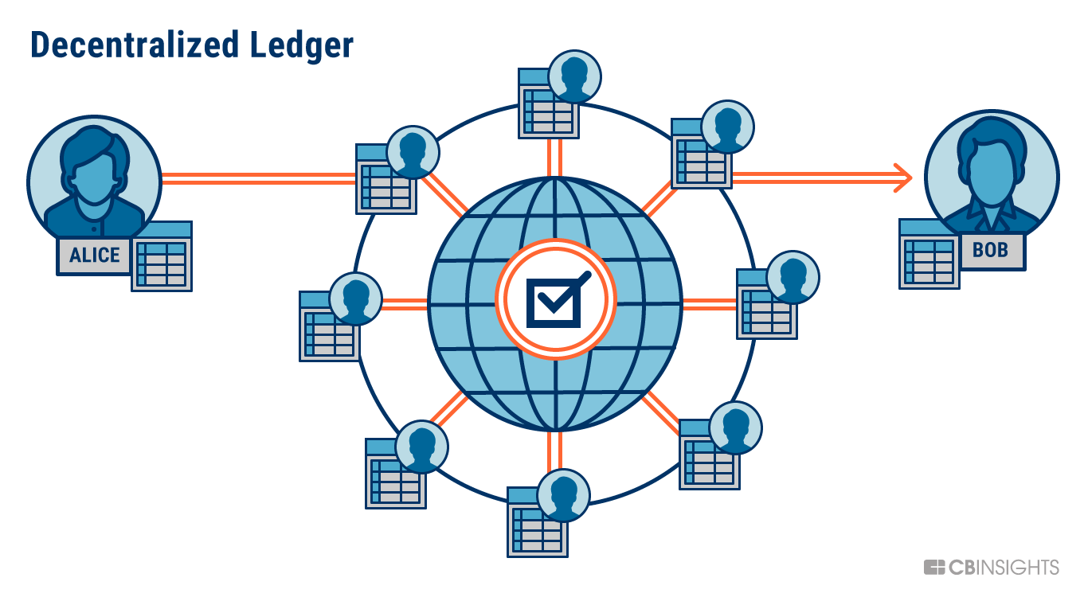
What is Decentralization?
Motivation:
There will be no Centralized Server
Hard to Hack (Almost Impossible)
Ensuring Confidentiality and Authentication

Slide 6
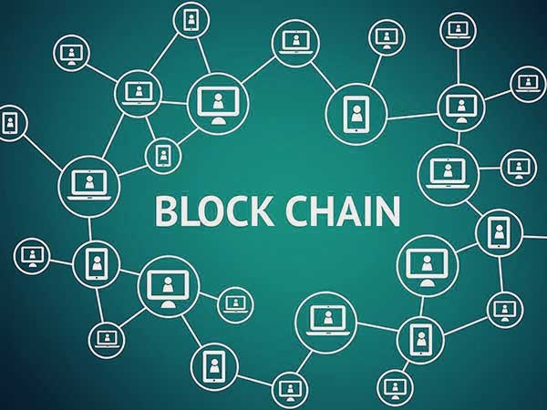
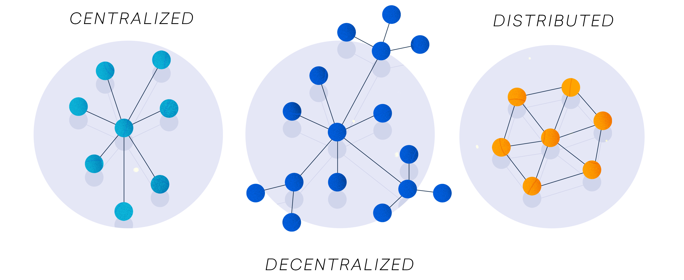
What is the Bridge for Decentralization?
Based on a combination of Decentralized and Distributed Ledger
Bitcoin is not a Blockchain rather Bitcoin only uses the Blockchain Technology.

Slide 7

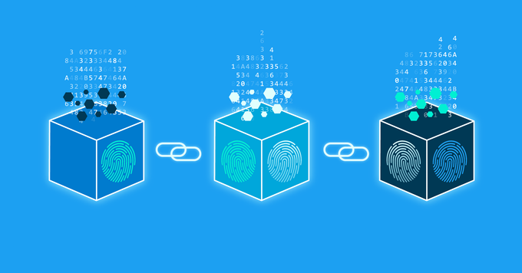
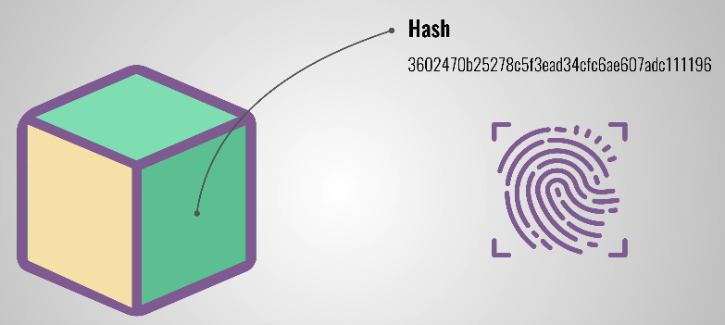
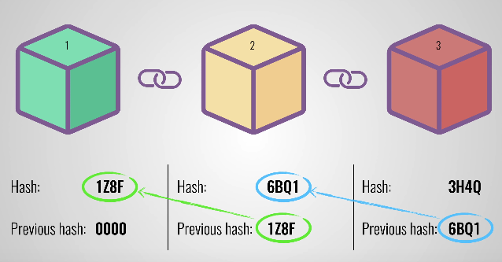
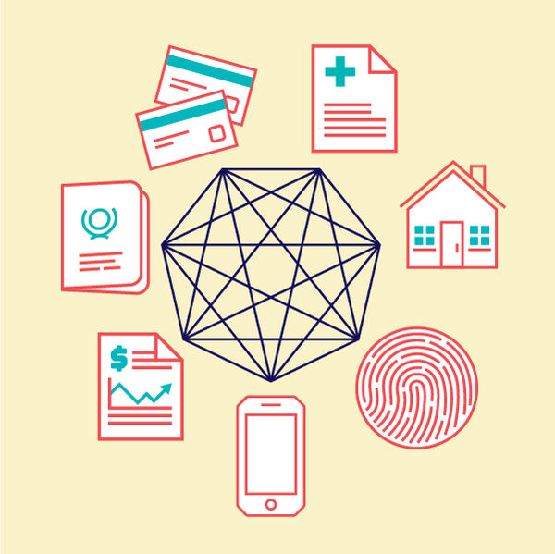
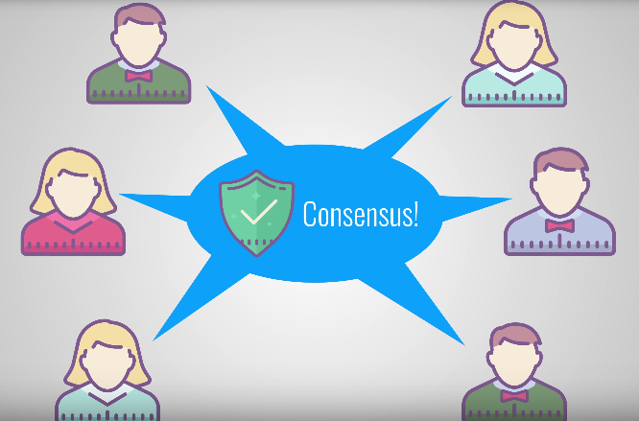
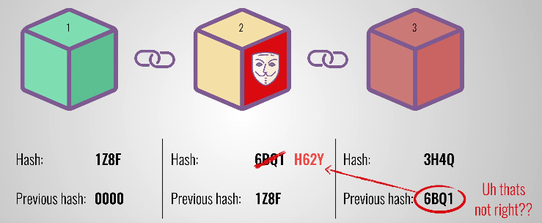
What is Blockchain?

Slide 8
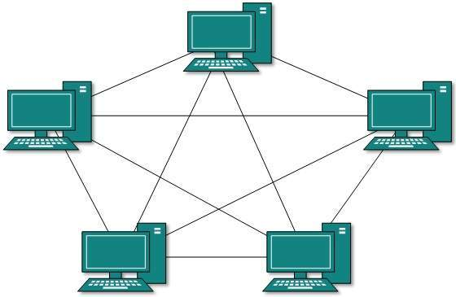
Proof of Work (PoW)
Proof of Stake (PoS)
GPU: 25
Stake: 0
GPU: 25
GPU: 5
Stake: 20
GPU: 20
Stake: 5
GPU: 5
GPU: 20
GPU: 10
Stake: 15
GPU: 10
GPU: 15
GPU: 15
Stake: 10

Slide 9
Proof of Deposit (PoD)
GPU: 25
Stake: 15
Eliminates the Malicious Nodes
GPU: 5
Stake: 15
GPU: 20
Stake: 15
GPU: 10
Stake: 15
GPU: 15
Stake: 15

Slide 10
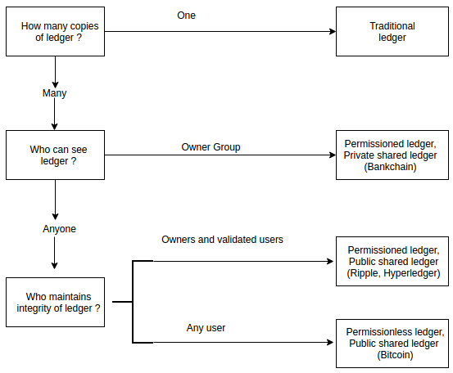
Types of Blockchain
According to the Participants:
Blockchain
Public
Private
Federated
According to the Permission:
Blockchain
Permissioned
Permissionless

Slide 11
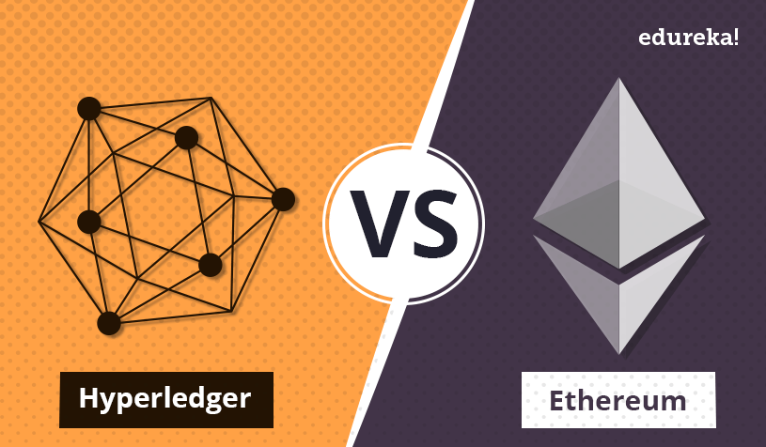
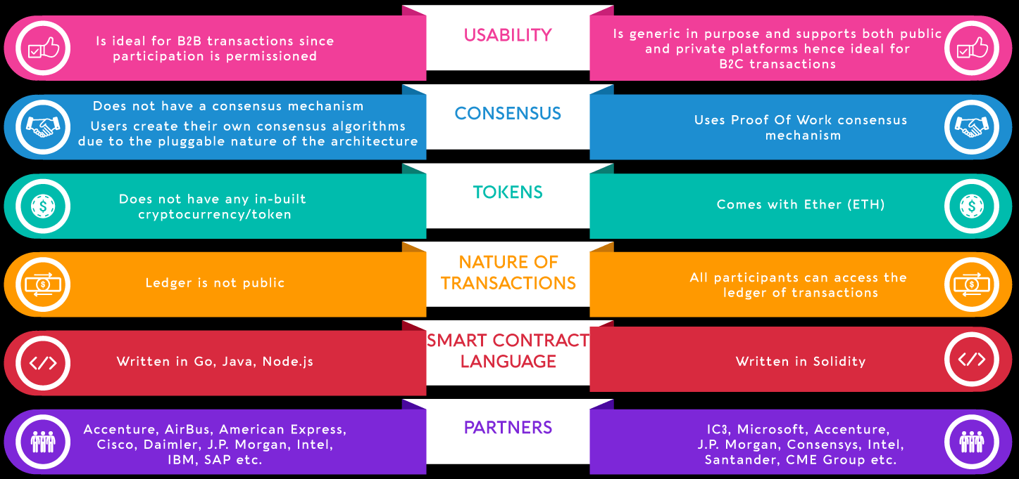

Slide 12
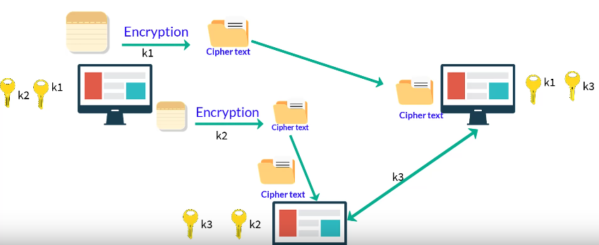
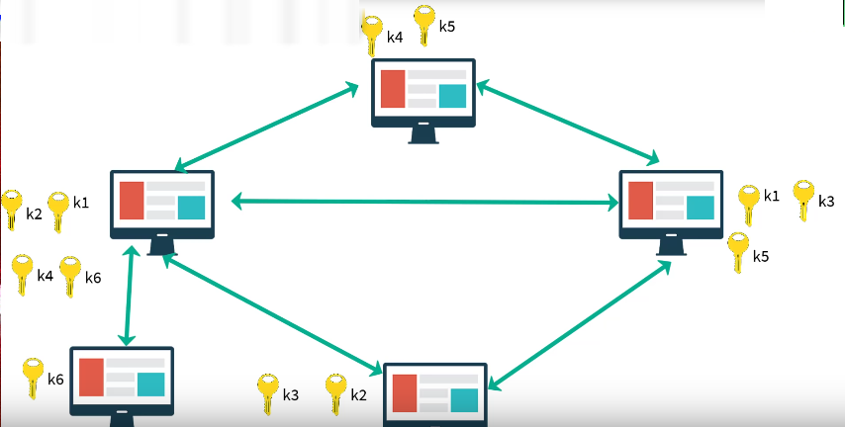
Types of Cryptography:
Symmetric
Cryptography

Slide 13
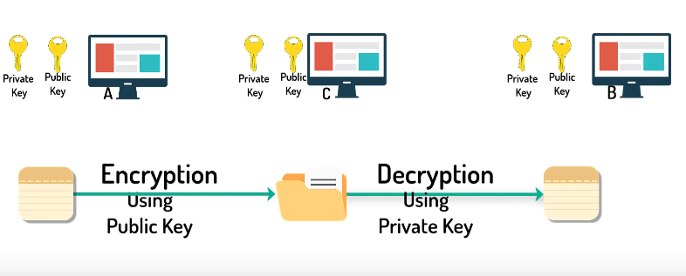
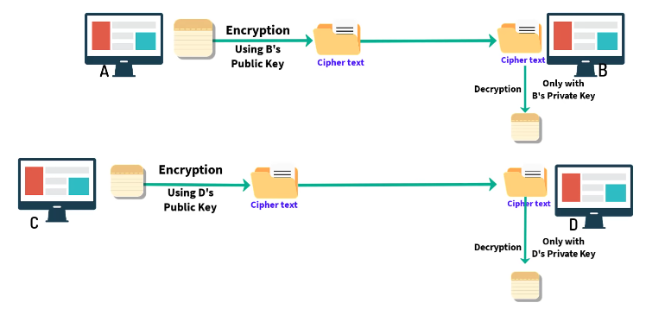
Types of Cryptography:
Asymmetric
Cryptography

Slide 14
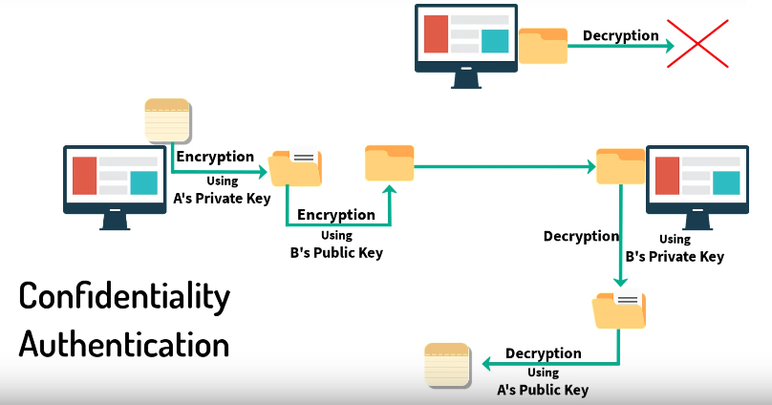
Digital Signature:
Based on Asymmetric Cryptography

Slide 15

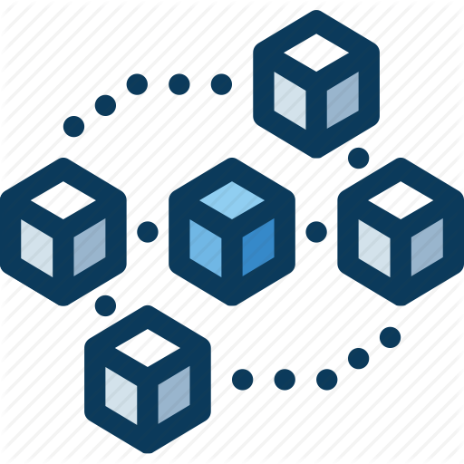


The Fields of Blockchain:
.
.
SocialMedia
Blockchain
Healthcare
FinancialServices

Slide 16
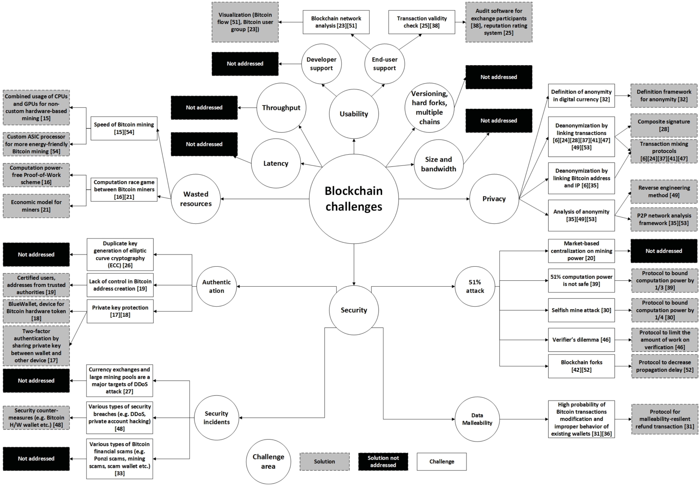
The Challenges of Blockchain:

Slide 17
Thank You

